Slide 1


More on multi-object consistency
Computer System Principle (2023 Fall)
Xingda Wei
IPADS, Shanghai Jiao Tong University
https://www.sjtu.edu.cn
Credits: Rong Chen@IPADS, jinyang Li@NYU

Slide 2
Scalable websites overview
Scalable websites powered by distributed systems
For request handling, data storage
Caching server
Caching server
Caching server
…
Caching
Caching
Caching
Distributed caching
Database server
Database server
CDN
Users
Application #1
generate the page
Database
user, price
…
Database
user, price
Application server
Distributed database
Internet
Load
Balance
Application #2
add the order
File server
File server
File server
File:
image
File:
image
…
File:
image
Application server
…
…
Message queue
Distributed file system
Notes:
分布式系统

Slide 3
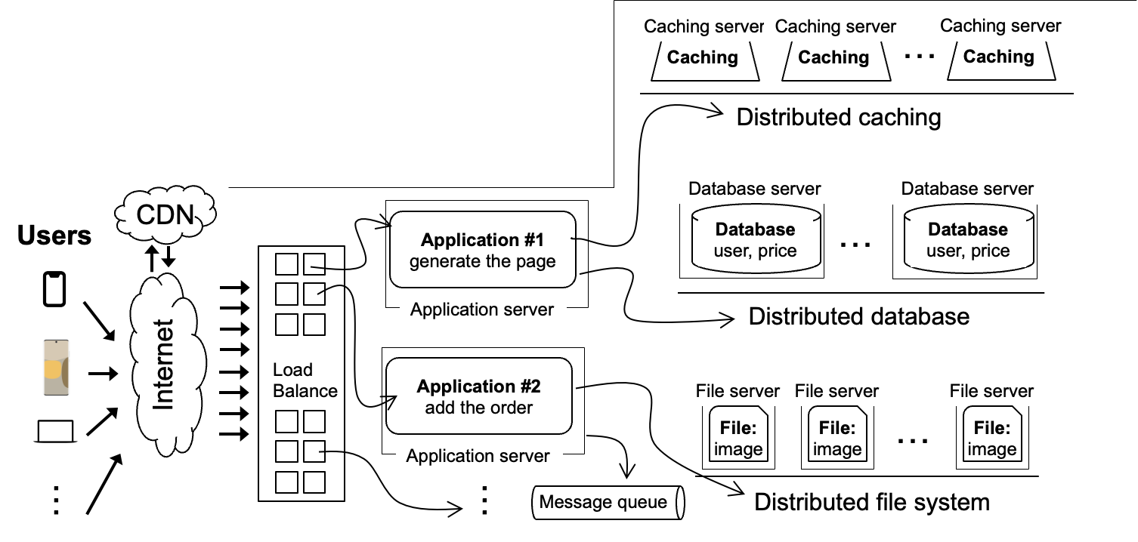
Scalable websites overview
Scalable websites powered by distributed systems
For request handling, data storage
Database server
Database server
Database
user, price
…
Database
user, price
Distributed database
Notes:
目前的lecture主要focus在存储上

Slide 4
Requirements considered by the storage system
Consistency
Is the returned data correct?
Performance
How fast is my data access?
Reliability
Can my stored data tolerate failures?
Notes:
尽管存储系统有很多， 他们的system需求是固定的
互相影响的topic

Slide 5
Review: consistency can break in many cases
For single object reads and writes
Replication (including caching)
Failure (not covered now)
For an operation that involved multiple objects reads & writes (it can also involve reading and writing the same objects )
Race conditions

Slide 6
Review: What is the right consistency model?
It's easy for users to reason about correctness assuming
Everything has only one-copy
The overall behavior is equivalent to some serial behavior
Typically, a convenient consistency model is defined by
Every data has only “one copy” (logically)
The concurrent read/write behavior is equivalent to some serial order
Question: which serial order to give?
So many (possible) serial behaviors, strict, linearizability, etc.

Slide 7
Review: before-or-after atomicity (a.k.a, Isolation)
To prevent hazard produced by race condition, we need a group of reads/writes to be atomic
E.g., cannot see/overwrites the intermediate states of a concurrent action
A concurrent action may have multiple linearizable reads/writes
Before or after atomicity
Concurrent actions have the before-or-after property if their effect from the point of view of their invokers is as if the actions occurred either completely before or completely after one another

Slide 8



Review: Two-phase locking (2PL)
…
Fine-grained locking:
Each shared data has one lock
E.g., a lock for Alice & a lock for Bob
2PL locking rule:
The action must acquire the shared data’s lock before access it, and releases it after the data access finishes and release it until the action finishes
Bank = [
Alice: 0¥
Bob: 0¥
Lock = [

Slide 9
Remaining issue: deadlock

Slide 10
Deadlock
Two-phase lock is pessimistic:
Before proceed, each TX must wait for conflicting TX to release the lock
What can happen if two TX are waiting for each other?
Fine-grained locking + 2PL
Transfer(bank, locks, a, b, amt):
Acquire(lock[b]
bank[b] += amt
Acquire(lock[a])
bank[a] -= amt
Release(lock[a])
Release(lock[b])
Audit(bank):
sum = 0
for acct in bank:
Acquire(locks[acct])
sum += bank[acct]
print(sum)
ReleaseAllLocks(...)

Slide 11
Deadlock: what if Thread 1 first acquires lock[a]?
Thread 0 (Transfer) | Thread 1 (Audit) | Bank[Alice] | Bank[bob] | Sum
 |  | 10 | 10 | 0
Acquire(lock[b]) | Acquire(lock[b]) | 10 | 10 | 0
Read(b) = 10 | Acquire(lock[b]) | 10 | 10 | 0
Write(b) = 20 | Acquire(lock[b]) | 10 | 20 | 0
Acquire(lock[a]) | Acquire(lock[b]) | 10 | 20 | 0
Read(a) = 10 | Acquire(lock[b]) | 10 | 10 | 0
Write(a) = 0 | Acquire(lock[b]) | 0 | 20 | 0
Release(lock[b]) | Acquire(lock[b]) | 0 | 20 | 0
 | Read(b) = 20 Acquire(lock[a]) Read(a) = 0 Release(lock[a]) | 0 0 0 0 | 20 20 20 20 | 20 20 20 20

Slide 12
Deadlock: what if Thread 1 first acquires lock[a]?
Thread 0 (Transfer) | Thread 1 (Audit) | Bank[Alice] | Bank[bob] | Sum
 |  | 10 | 10 | 0
Acquire(lock[b]) | Acquire(lock[a]) | 10 | 10 | 0

Slide 13
Deadlock: what if Thread 1 first acquires lock[a]?
Thread 0 (Transfer) | Thread 1 (Audit) | Bank[Alice] | Bank[bob] | Sum
 |  | 10 | 10 | 0
Acquire(lock[b]) | Acquire(lock[a]) | 10 | 10 | 0
Read(b) = 10 | Read(a) = 10 | 10 | 10 | 10

Slide 14
Deadlock: what if Thread 1 first acquires lock[a]?
Thread 0 (Transfer) | Thread 1 (Audit) | Bank[Alice] | Bank[bob] | Sum
 |  | 10 | 10 | 0
Acquire(lock[b]) | Acquire(lock[a]) | 10 | 10 | 0
Read(b) = 10 Acquire(lock[a]) | Read(a) = 10 Acquire(lock[b]) | 10 | 10 | 10

Slide 15
Deadlock: what if Thread 1 first acquires lock[a]?
Thread 0 (Transfer) | Thread 1 (Audit) | Bank[Alice] | Bank[bob] | Sum
 |  | 10 | 10 | 0
Acquire(lock[b]) | Acquire(lock[a]) | 10 | 10 | 0
Read(b) = 10 Acquire(lock[a]) Acquire(lock[a]) | Read(a) = 10 Acquire(lock[b]) Acquire(lock[b]) | 10 | 10 | 10
Question: can thread 0 or thread 1 finishes the execution?

Slide 16
Methods for resolving the deadlock
1. Acquire locks in a pre-defined order
Not support general TX: TX must know the read/write sets before execution
2. Detect deadlock by calculating the conflict graph
If there is a cycle, then there must be a deadlock
Abort one TX to break the cycle
High cost for detection
3. Using heuristics (e.g., timestamp) to pre-abort the TXs
May have false positive, or live locks
Prevention
Detection
Retry

Slide 17
Issues of 2PL
Deadlock
Typically, hard to prevent and detect in practice
Locking overhead (overhead to acquire the lock + wait for the lock release)
What are the root cause of the above issues of 2PL?
It pessimistically avoids race conditions

Slide 18
Can we run transaction optimistically?

Slide 19



Optimistic concurrency control
Executing TXs optimistically w/o acquiring the lock
Checks the results of TX before it commits
If violate serializability, then aborts & retries
First proposed in 1981, widely used today

Slide 20
OCC Executes a Transaction in 3 Phases
Phase 1: Concurrent local processing
Reads data into a read set
Buffers writes into a write set
Phase 2: Validation serializability in critical section
Validates whether serializability is guaranteed:
Has any data in the read set been modified?
Phase 3: Commit the results in critical section or abort
Aborts: aborts the transaction if validation fails
Commits: installs the write set and commits the transaction

Slide 21
OCC Executes a Transaction in 3 Phases
Before phase one, TX needs to allocate the execution context
Read-set & write set
...
tx.begin();
...
tx.read(A)
...
tx.commit();
...
Init read_set
Init write_set

Slide 22
OCC Executes a Transaction in 3 Phases
Phase 1:
Reads data into a read set
Buffers writes into a write set
This step should be atomic!
...
tx.begin();
...
tx.read(A)
...
tx.commit();
...
val_a = read(A)
read_set.add(val_a)

Slide 23
OCC Executes a Transaction in 3 Phases
Phase 1:
Reads data into a read set
Buffers writes into a write set
What about a second read?
Read from the read-set!
Why? Need to provided repeated read!
...
tx.begin();
...
tx.read(A)
tx.read(A)
tx.commit();
...
if A in read_set:
return read_set[A]

Slide 24
OCC Executes a Transaction in 3 Phases
Phase 1:
Reads data into a read set
Buffers writes into a write set
...
tx.begin();
...
tx.read(A)
tx.write(A)
tx.commit();
...
Write_set[A] = ..
if A in read_set:
read_set[A] = ..
Notes:
假设A之前没有被TX写过，即A只写一次

Slide 25
OCC Executes a Transaction in 3 Phases
Phase 2:
Validates whether serializability is guaranteed:
Has any data in the read set been modified?
...
tx.begin();
...
tx.read(A)
...
tx.commit();
...
for d in read_set:
if d has changed:
abort()

Slide 26
OCC Executes a Transaction in 3 Phases
Phase 3:
Aborts: aborts the transaction if validation fails
Commits: installs the write set and commits the transaction
...
tx.begin();
...
tx.read(A)
...
tx.commit();
...
for d in read-set:
if d has changed:
abort()
for d in write_set:
write(d)

Slide 27
OCC Executes a Transaction in 3 Phases
Phase 3:
Aborts: aborts the transaction if validation fails
Commits: installs the write set and commits the transaction
Phase 2 & 3 should execute in a critical section (no race condition)
Otherwise, what if a value has changed during validation?
...
tx.begin();
...
tx.read(A)
...
tx.commit();
...
Critical section
for d in read_set:
if d has changed:
abort()
for d in write_set:
write(d)

Slide 28
Why phase 2 & phase 3 must be in critical section?
Both TX:
A += 1
B += 1
Time
T1
T2
Read(A_{T0})
Phase #1
Read(B_{T0})
Read(A_{T0})
Read(B_{T0})
Phase #2
Validate(A_{T0})
Validate(B_{T0})
Validate(A_{T0})
Validate(B_{T0})

Slide 29
Why phase 2 & phase 3 must be in critical section?
Both TX:
A += 1
B += 1
Time
T1
T2
Read(A_{T0})
Phase #1
Read(B_{T0})
Read(A_{T0})
Read(B_{T0})
Phase #2
Validate(A_{T0})
What happen we execute phase #3?
Validate(B_{T0})
Validate(A_{T0})
Validate(B_{T0})
Phase #3
Write(A, A_{T0} + 1)
Write(A , A_{T0} + 1)

Slide 30
How to implement the critical section for phase 2 & 3?
Global lock may satisfy
The phase 2 & 3 are typically short
No TX logic is executed, only the validation
def validate_and_commit() // phase 2 & 3
global_lock.lock()
for d in read-set:
if d has changed:
abort()
for d in write-set:
write(d)
global_lock.unlock()

Slide 31
How to implement the critical section for phase 2 & 3?
Using two-phase locking
Allow more concurrency
What about the problem of deadlock?
def validate_and_commit() // phase 2 & 3
for d in read-set:
d.lock()
if d has changed:
abort() // abort will release all the held lock
for d in write-set:
d.lock()
write(d)
// release the locks
...

Slide 32
How to implement the critical section for phase 2 & 3?
Using two-phase locking
Allow more concurrency
Use sort to avoid deadlock; but still has the same locking overhead as 2PL
Question: do we need to lock the read-set?
def validate_and_commit() // phase 2 & 3
for d in sorted(read-set + write-set):
d.lock()
for d in read-set:
if d has changed:
abort()
for d in write-set:
write(d)
// release the locks
...

Slide 33
How to implement the critical section for phase 2 & 3?
Observation (for the read-set):
If the validation passes, then it ”appears“ that a lock is held during
def validate_and_commit() // phase 2 & 3
for d in sorted(read-set + write-set):
d.lock()
for d in read-set:
if d has changed:
abort()
for d in write-set:
write(d)
// release the locks
...

Slide 34
How to implement the critical section for phase 2 & 3?
Observation (for the read-set):
If the validation passes, then it ”appears“ that a lock is held during
Question: is the following implementation correct?
def validate_and_commit() // phase 2 & 3
for d in sorted(write-set):
d.lock()
for d in read-set:
if d has changed:
abort()
for d in write-set:
write(d)
// release the locks
...

Slide 35

Problem: read-write conflict
T1:
A += B
T2:
B += A
Time
T1
T2
Read(A_{T0})
Phase #1
Read(B_{T0})
Read(A_{T0})
Read(B_{T0})
Missing the lock!
Phase #2
Lock(A)
Validate(B_{T0})
Lock(B)
Validate(A_{T0})
Write(A, A_{T0} + B_{To})
Write(B, A_{T0} + B_{To})

Slide 36
How to implement the critical section for phase 2 & 3?
Use two-phase locking + read validation
Only lock the write set, after that,
Check the read set has not changed & locked
def validate_and_commit() // phase 2 & 3 with before-or-after
for d in sorted(write-set):
d.lock()
for d in read-set:
if d has changed or d has been locked:
abort()
for d in write-set:
write(d)
// release the locks
...
Notes:
check完相当于放锁

Slide 37
OCC: An Example
Tuple A in T1's read set has been changed by T2, thus T1 must be aborted.
Thread1
Thread2
T1:
B = A + B;
T2:
A = A * 1.1;
T2's read set remains unchanged, thus T2 is allowed to commit
BEGIN
BEGIN
T1's read set:
A (100)
B (100)
R(A);
R(A);
T2's read set:
A (100)
B (200)
R(B);
W(A);
T1's write set:
T2's write set:
A (110)
W(B);
Commit
Validation
Thread-local memory
Abort
Validation
Thread-local memory
Time
Database
storage
ID | Value
A | 110
B | 100
ID | Value
A | 100
B | 100

Slide 38
OCC Advantages
Phase 1: Concurrent local processing
Reads data into a read set
Buffers writes into a write set
Phase 2: Validation in critical section
Validates whether serializability is guaranteed:
Has any data in the read set been modified?
Phase 3: Commit the results in critical section or abort
Aborts: aborts the transaction if validation fails
Commits: installs the write set and commits the transaction
Operates in private workspace; rare inter-thread synchronization (optimistic)

Slide 39
OCC Advantages
Phase 1: Concurrent local processing
Reads data into a read set
Buffers writes into a write set
Phase 2: Validation in critical section
Validates whether serializability is guaranteed:
Has any data in the read set been modified?
Phase 3: Commit the results in critical section or abort
Aborts: aborts the transaction if validation fails
Commits: installs the write set and commits the transaction
Needs synchronization (e.g., with lock), but usually very short at low contention

Slide 40
OCC Advantages
Use reads more than writes (for each read-only data access)
OCC (in the optimal case, i.e., no abort)
1 read to read the data value
1 read to validate whether the value has been changed or not (as well as locked)
2PL
1 operation to acquire the lock (typically an atomic CAS)
1 read to read the data value
1 write to release the lock
A single CPU write is atomic, no need to do the atomic CAS
Locking is costly especially compared to reads

Slide 41
Locking preliminary
Many implementation exists to achieve the best performance & scalability
Still an active topic in system research
We will focus on the basic design
The details will be left to the OS class
Basic impl: using a flag to indicate whether the log is hold
Acquire: read the current flag, if not locked, then set it as locked
Interestingly, acquiring the lock itself also requires before-of-after
Both threads will read the current lock status
If the status is not locked, update it to locked
What if two threads concurrently read an unlocked state?

Slide 42
Locking preliminary: atomic compare and swap
Hardware primitive to guarantee before-or-after atomicity
Compare-and-swap (on SPARC)
Compare-and-exchange (on x86)
Lock prefix to ensure an instruction is atomically executed on a memory address
1 int CompareAndSwap(int *ptr, int expected, int new) {
2 int actual = *ptr;
3 if (actual == expected)
4 *ptr = new;
5 return actual;
6 } // hardware ensures atomicity
Notes:
x86 provides a “lock” prefix that tells the hardware: “don’t let anyone read/write the value until I’m done with it”
An instruction for atomic CAS

Slide 43
Locking (Spin Lock) using Compare-and-swap
1 typedef struct __lock_t {
2 int flag;
3 } lock_t;
4
5 void init(lock_t *lock) {
6 // 0 indicates that lock is available, 1 that it is held
7 lock->flag = 0;
8 }
9
10 void lock(lock_t *lock) {
11 while (CompareAndSwap(&lock->flag, 0, 1) == 1)
12 ; // spin-wait (do nothing)
13 }
14
15 void unlock(lock_t *lock) {
16 lock->flag = 0;
17 }

Slide 44
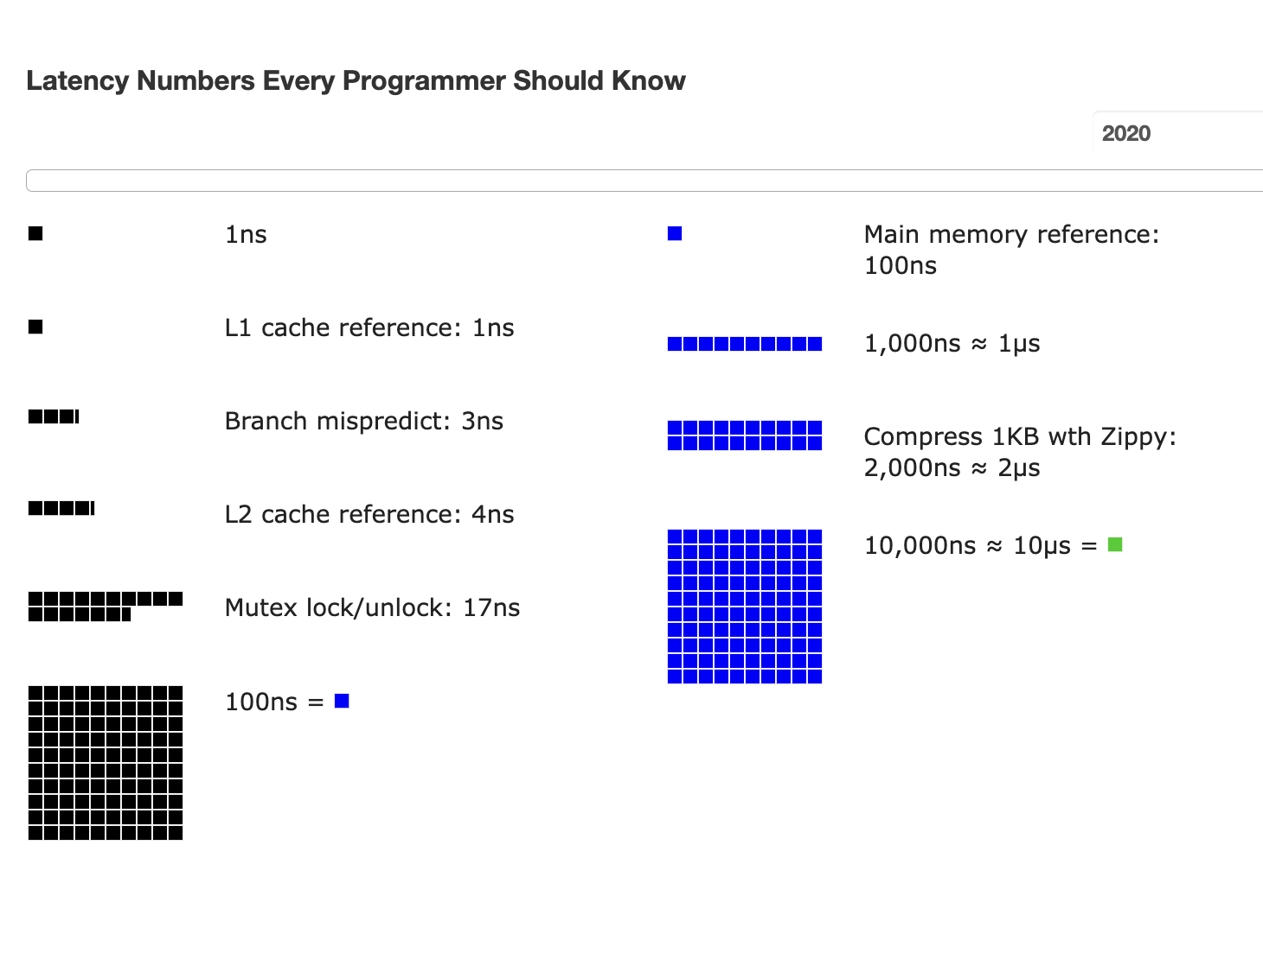
Atomic operations are costly for spin lock

Slide 45
OCC's Problem: False Aborts
Some transactions aborted by OCC could have been allowed to commit without causing an unserializable schedule
Thread1
Thread2
T1:
B = A + B;
T2:
A = A * 1.1;
No cycle is formed
OCC only allows serialized execution of T2, T1, but is not able to recognize serialized execution of T1, T2.
T1 is falsely aborted
BEGIN
BEGIN
R(A);
rw
R(A);
R(B);
W(A);
W(B);
Commit
Abort

Slide 46
OCC's Problem: False Aborts
Some transactions aborted by OCC could have been allowed to commit without causing an unserializable schedule
Especially for TXs with a lot of reads
E.g., read a lot of items → large read set → easier to abort
May abort even under low-contention
Notes:
因为执行的时间很长，所以会abort

Slide 47
OCC's Problem: livelock
Under high contention, OCC may continuously abort
Especially with large read/write sets, or long execution time
Transaction is executing, but no progress!

Slide 48
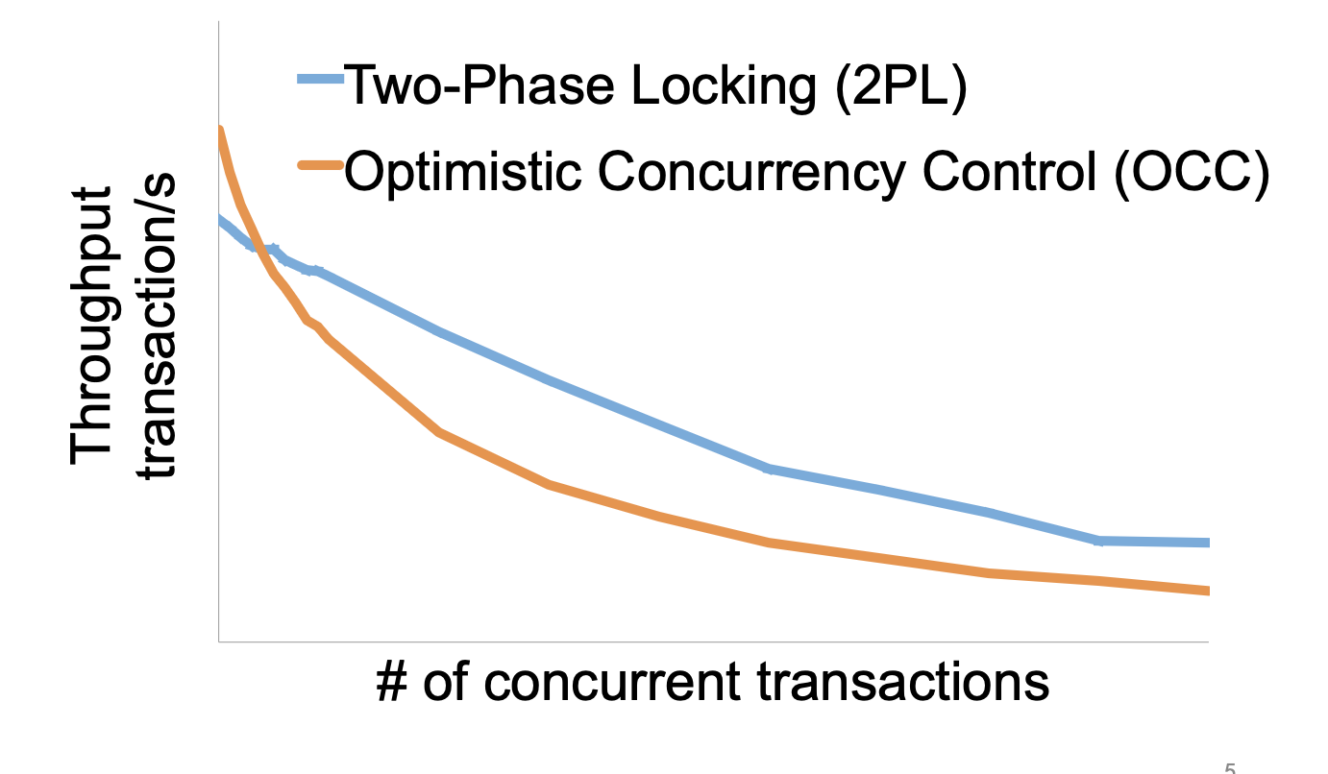
2PL vs. OCC: in a nutshell
Source: Extracting More Concurrency from Distributed Transactions [OSDI'14]

Slide 49
OCC and hardware transactional memory

Slide 50

Hardware Transactional Memory
A new CPU feature for writing concurrent programs
CPU guarantees the before-or-after atomicity of memory reads/writes
i.e., no race conditions & no need for 2PL & (Software-implemented) OCC!
Intel supports HTM named as RTM
Restricted Transactional Memory
First released in Haswell processor
Other implementations still exist
E.g., ARM Transactional Memory Extension (TME)

Slide 51

Does RTM[*] solve all the problem?
Restricted transactional memory
* Since we focus on RTM in this lecture, we will use RTM and HTM interchangeably.

Slide 52
A little introduction to RTM’s ISA
ISA support for transactional memory
Recall: Writing with TX is straightforward
Use TX.begin to mark when a TX starts
Use TX.commit to commit the TX
In RTM, the concept is similar (using new instructions)
Use xbegin to mark an RTM execution start
Use xend to mark an RTM end

Slide 53
Programming with RTM
If transaction starts successfully
Do work protected by RTM, and then try to commit
Fallback routine to handle abort event
If abort, system rollback to xbegin, return an abort code
Manually abort inside a transaction
if _xbegin() == _XBEGIN_STARTED:
if conditions:
_xabort()
critical code
_xend()
else
fallback routine

Slide 54
Programming with RTM
If transaction starts successfully
Do work protected by RTM, and then try to commit
Fallback routine to handle abort event
If abort, CPU rollbacks to line xbegin, return an abort code, and goto fallback
Manually abort inside a transaction
if _xbegin() == _XBEGIN_STARTED:
if conditions:
_xabort()
critical code (access x)
_xend()
else
fallback routine
Another process
x = 1

Slide 55
Programming with RTM
If transaction starts successfully
Do work protected by RTM, and then try to commit
Fallback routine to handle abort event
If abort, CPU rollbacks to line xbegin, return an abort code, and goto fallback
Manually abort inside a transaction
if _xbegin() == _XBEGIN_STARTED:
if conditions:
_xabort()
critical code
_xend()
else
fallback routine

Slide 56
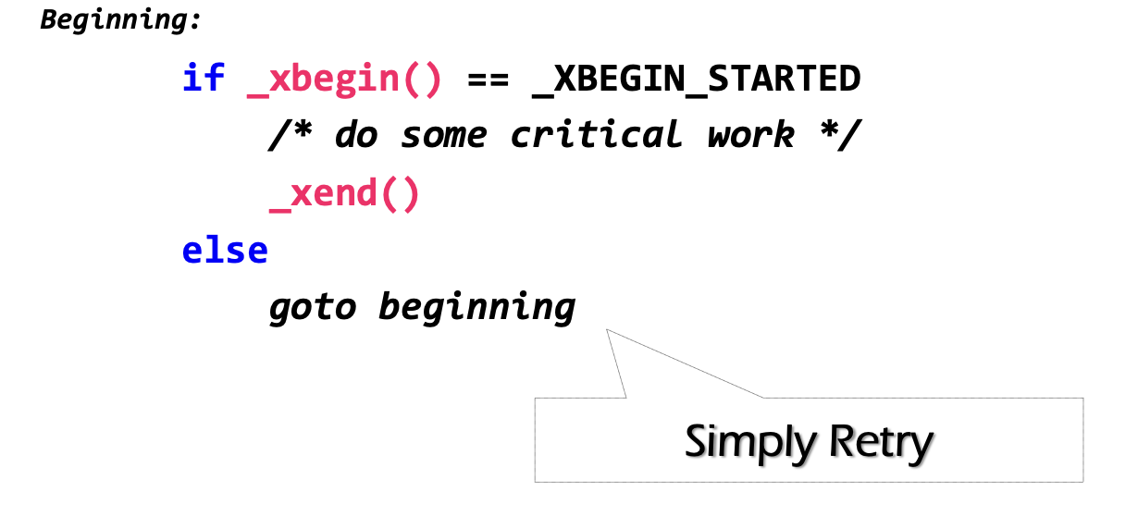
How to handle aborts? Can we use simple retry?
RTM provides new instruction set
xbegin(), xend() & xabort()
Problem: RTM cannot guarantee success

Slide 57
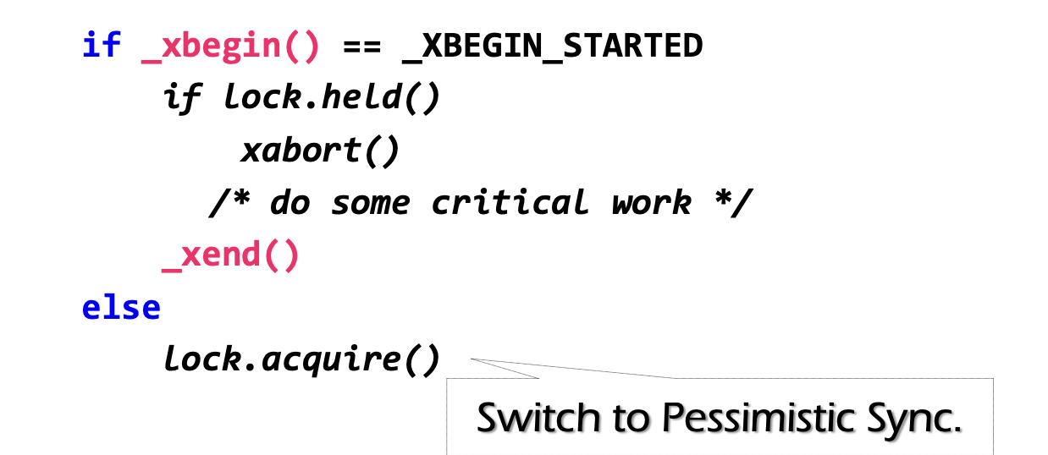
Can we use simple retry? No
Problem: RTM cannot guarantee success
Similar to OCC, code in RTM can be frequently aborted due to conflicts
Must switch to a fallback path after some reties (e.g., using a counter)
E.g., degrade to use lock in the fallback path (since it's not in a transaction)
check lock status to avoid conflict with fallback handlers on other CPU

Slide 58
Fun facts about the implementation of RTM
The benefits of RTM
Memory operations between xbegin() & xend()satisfy ACI properties
HTM itself is inspired from transactions
Drawbacks
Cannot guarantee success
Sounds familiar?

Slide 59
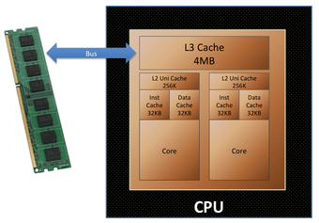
Fun facts about the implementation of RTM
The benefits of RTM
Memory operations between xbegin() & xend()satisfy ACI properties
HTM itself is inspired from transactions
Drawbacks
Cannot guarantee success
Intel implements RTM using OCC
Use CPU cache to track the read/write sets
How to detect conflicts? Based on cache coherence protocols
Questions: what are the other limits of using CPU cache to tack read/write sets?

Slide 60
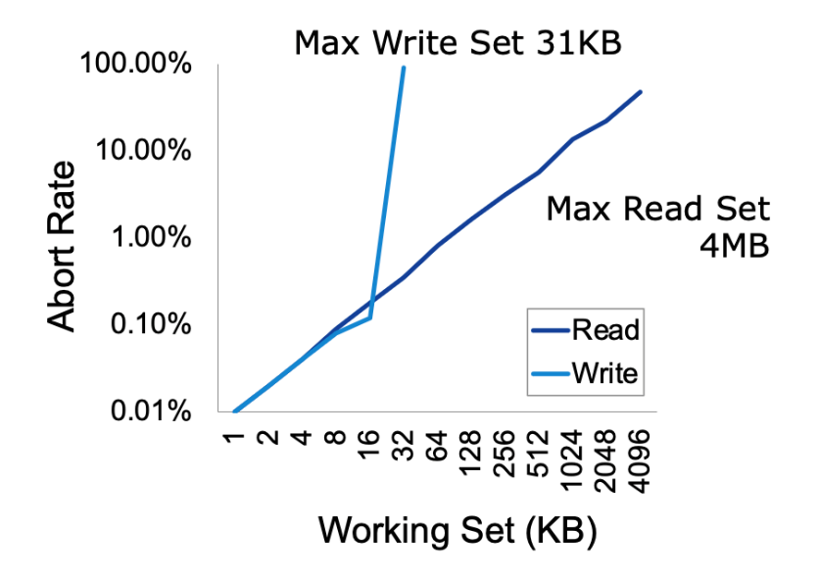
Another drawback of RTM: limited working set
Reason: CPU has limited cache size
How big is the RTM read/write sets?
Depends on various factors
Hardware setup (e.g., CPU cache size)
Access pattern: read or write
L1 cache tracks all the writes
L2, or L3 to tracks all the reads
Why read set is bigger?

Slide 61
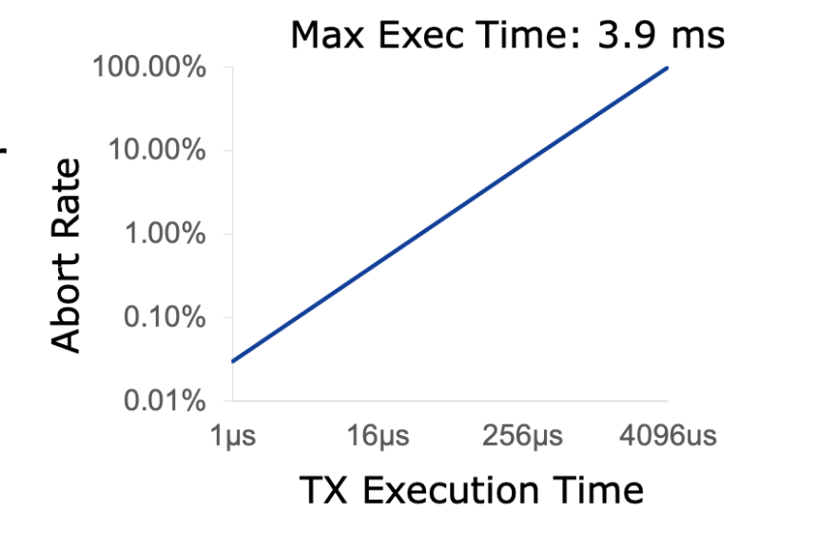
How long can an RTM program execute?
Not very long
The longer the execution, the higher the probability a TX aborts
Affected by other facts, e.g., CPU interrupts

Slide 62
HTM on transactions
Naïve: using HTM to execute the in-memory transaction
Smallbank: transfer &. Audit
TPC-C: much complex, insert 10+ orders and update 10+ stocks
Silo@SOSP’13: the fastest in-memory OCC implementation

Slide 63
Short summary of RTM
Hardware support for transactional memory
Easy programming model for the programmer (no need to wrap transaction in read/write API of the transaction)
As long as the programmer do the in-memory computations, e.g., in-memory database
Good performance if using properly
No need for locking & atomic operations
However, the programmer should handle its pitfalls

Slide 64

OCC & 2PL are bad when TXs are long running w/ many reads
OCC: abort due to read validation fails
2PL: read will hold the lock and block others
Yet, reads are common in applications
e.g., for Taobao, we rarely add items, but extensively read the items
Scenario: long-running read-only or read-mostly transactions
run analytics on a companion data, while update a piece of data
long running read-only transaction
Notes:
因为执行的时间很长，所以会abort

Slide 65
Can we avoid validation for reads?

Slide 66
Abort in OCC
T1:
Print(A+B)
T2:
B = 2
A = 3
Time
T1
T2
Read(A_{T0})
Read(B_{T0})
Write(A_{T2})
Write(B_{T2})
Validate(A)
Abort!

Slide 67
Abort in OCC
T1:
Print(A+B)
T2:
B = 2
A = 3
Time
T1
T2
Read(A_{T0})
Read(B_{T0})
Do we necessarily need to abort T1?
Write(A_{T0})
Write(B_{T2})
Validate(A)
Abort!

Slide 68
Abort in OCC case (2)
T1:
Print(A+B)
T2:
B = 2
A = 3
Time
T1
T2
Read(A_{T0})
Write(A_{T2})
Write(B_{T2})
Read(B_{T2})
Validate(A)
Question: can we avoid aborting T1?
Abort!

Slide 69
Abort in OCC case (2)
T1:
Print(A+B)
T2:
B = 2
A = 3
Time
T1
T2
Read(A_{T0})
Write(A_{T2})
Write(B_{T2})
Read(B_{T0})
Read(B_{T2})
Overwrite

Slide 70
Idea: multi-versioning concurrency control
Each data has multiple-versions instead of a single version
A set of version represents a snapshot of the database
E.g., A_{T0} + B_{T0}
The version ~= the time a TX makes the updates
Data
VersionedData
X₀
X₁
X
Struct Data {
value : u8[…]
lock : lock_t
}
Struct Data {
value: List<VersionedData>
lock : lock_t
}
Struct VersionedData {
value: u8[…]
version: u64
}

Slide 71
Idea: multi-versioning concurrency control
Read
Only read from a consistent snapshot at a start time
Write
Install a new version of the data instead of overwriting the existing one
Version ~= the commit time of the TX
Goal: avoid race conditions on reading a snapshot
Data
VersionedData
X₀
X₁
X
Struct Data {
value : u8[…]
lock : lock_t
}
Struct Data {
value: List<VersionedData>
lock : lock_t
}
Struct VersionedData {
value: u8[…]
version: u64
}

Slide 72
Get the start and commit time
Requirement: the counter reflects TX’s serial execution order
E.g., if T1 finishes before T2, it will has a smaller start & commit timestamp
Simplest (& most widely used) solution: global counter
Using atomic fetch and add (FAA) to get at the TX’s begin & commit time
TX Begin: use FAA to get the start time
TX Commit: use FAA to get the commit time
We will introduce more advanced timestamps in later lectures
Not using a global counter is challenging because de-centralized time (e.g., physical time) is unsynchronized

Slide 73
Try #1: Optimize OCC w/ MV (incomplete)
Acquire the start time
Phase 1: Concurrent local processing
Reads data belongs to the snapshot closest to the start time
Buffers writes into a write set
Acquire the commit time
Phase 2: Commit the results in critical section
Commits: installs the write set with the commit time
Compared to the OCC, no validation is need!

Slide 74
Try #1: Optimize OCC w/ MV (incomplete)
Commit(tx):
for record in tx.write_set:
lock(record)
let commit_ts = FAA(global_counter)
for record in tx.write_set:
record.insert_new_version(commit_ts, ...)
unlock(record)
Get(tx, record):
while record.is_locked():
pass
for version,value in record.sort_version_in_decreasing():
if version <= tx.start_time:
return value

Slide 75
Partial snapshot
T2:
B = 2
A = 3
T1:
Print(A+B)
Global counter g (initial 0)
T1
T2
1
Start_time = FAA(g)
A: A₀
B: B₀
Read(A) = A₀
2
Commit_time = FAA(g)
Write(B, B₂)
A: A₀
Read(B) = B₀
B: B₂ B₀
Write(A, A₂)
A: A₂ A₀
B: B₂ B₀
No validation needs here (for T1) !
Problem: partial updated snapshot

Slide 76
Partial snapshot example
T1:
Print(A+B)
T2:
B = 2
A = 3
Global counter (initial 0)
T1
T2
Needs to be atomic
A: A₀
1
Commit_time = FAA(g)
B: B₀
Write(B, B₁)
A: A₀
2
start_time = FAA(g)
B: B₁ B₀
Read(A) = A₀
Read(B) = B₁
A: A₁ A₀
Write(A, A₁)
B: B₁ B₀
Missing the updates! We need T2’s write being before-or-after atomic!

Slide 77
Enforcing the write atomicity of snapshot w/ locking
Commit(tx):
for record in tx.write_set:
lock(record)
let commit_ts = FAA(global_counter)
for record in tx.write_set:
record.insert_new_version(commit_ts, ...)
unlock(record)
Get(tx, record):
while record.is_locked():
pass
for version,value in record.sort_version_in_decreasing():
if version <= tx.start_time:
return value

Slide 78
Example revisit
T1:
Print(A+B)
T2:
B = 2
A = 3
Question: can we reorder get commit time and locking?
Global counter (initial 0)
T1
T2
Lock A, B
A: A₀
1
Commit_time = FAA(g)
B: B₀
Write(B, B₁)
Unlock B
A: A₀
2
start_time = FAA(g)
B: B₁ B₀
Read(A) = ?
A: A₀
Cannot read! Because A is locked!
B: B₁ B₀
A: A₁ A₀
Write(A, A₁)
B: B₁ B₀
Unlock A
Read(A) = A₁
Read(B) = B₁

Slide 79
What about writes?
T1:
A += 1
T2:
A += 1
Global counter (initial 0)
T1
T2
1
Start_time = FAA(g)
Read(A₀) = 0
2
Start_time = FAA(g)
Read(A₀) = 0
3
Commit_time = FAA(g)
Write (A_{3,} 1)
4
Commit_time = FAA(g)
Write (A_{4,} 1)

Slide 80
MVCC ensures no race for reads, but not writes
Race conditions of reads are isolated via snapshots
But we still needs to rule out race conditions between reads and writes
We do so by validating the writes at the commit time
The validation is simple:
During commit time, check whether another TX has installed a new snapshot after the committing TX’s start time

Slide 81
Put it together, MVCC so far
T is assigned a commit timestamp T.cts
System checks all data within T.wset, if T.sts < X.cts, then abort T
Update all data within T.wset with T.cts
T is assigned a start timestamp T.sts
T
START
READ(X)
WRITE(X)
COMMIT
Time
T reads the biggest version of X(i), such that X(i).cts <= T.sts
T buffers writes to X and adds X to its write-set, T.wset += {X}

Slide 82
Question: do our current MVCC method guarantee before-or-after?

Slide 83
Write skew anomaly
Our MVCC differs from serializability due to one anomaly
Describe the anomaly and also give a concrete application for which the anomaly is undesirable.
T1
S
R(X)
W(Y)
C
R(X) = X₀
W(Y) = Y₂
T2
S
R(Y)
W(X)
C
R(Y) = Y₀
W(X) = X₁
Possible Conflict Serial Order
X₀
X₁
T1
T2
Y₀
Y₂
T2
T1

Slide 84
Fixing the anomaly
The simplest way is to validate the read-set in read-write TX
Essentially fallbacks to OCC for read-write TX
But read-only TX can still enjoy the benefits from MVCC
Never aborts & no validations
Usually being ignored in practice (Snapshot isolation)
The MVCC without the read validation is also called snapshot isolation (SI)
Though the idea of MVCC is first proposed in SI, its usage is not restricted to it, e.g., we can have MV-2PL and MV-OCC; & we will see it later

Slide 85
Multi-site transaction &
Multi-site atomicity

Slide 86



Multi-site transaction: what if the data is distributed?
The data accessed by TXs are stored on multiple machines
i.e., a single site cannot store all the bank accounts
The setup
Client + coordinator + two servers
One server handles bank accounts A-M
The other server handles bank accounts N-Z
Coordinator and servers all have logs to ensure single transaction atomicity
Coordinators
e.g., frontend servers
Storage servers
e.g., key-value stores
Clients,
e.g., iPhone
A - M
N - Z

Slide 87

Deposit(bank, a, amt):
bank[a] += amt
Multi-site transaction
e.g., coordinator sends multiple deposit to different servers
They use RPCs to send requests to the server to execute transaction
发工资(bank, accts, amt):
for acct in accts:
deposit(bank, acct, amt)
发工资
Coordinator
Server 0
deposit(“Alice”)
Audit(“Zack”)
Server 1
Time

Slide 88
Multi-site transaction
Coordinator sends multiple deposit to different servers
They use RPCs to send requests to the server to execute transaction
发工资(bank, accts, amt):
for acct in accts:
deposit(bank, acct, amt)
发工资
Coordinator
Server 0
deposit(“Alice”)
deposit(“Zack”)
Server 1
Time
What if one server commits and the other aborts?

Slide 89
Goal: all sites either all commits or all aborts

Slide 90
Two-phase Commit: a way to ensure multi-site atomicity
High-layer TX
The high-level view of the TX
Low-layer TX
Specific reads and writes that executed on a single machine
Higher-layer transaction coordinates the execution of lower-layer TXs
All low-layer TX either all commits or all aborts
发工资(bank, accts, amt):
tx.high_begin()
for acct in accts:
deposit(bank, acct, amt)
tx.high_commit()
High-layer TX
Deposit(bank, a, amt):
tx.low_begin()
bank[a] += amt
tx.low_commit()
Low-layer TX

Slide 91
We also aggregate scattered accesses as low-layer TX
The coordinator can send scattered reads/writes to a site
The reads and writes on that site also form a low-layer TX
Coordinator
Storage server
A - M
Storage server
N - Z
accts[“alice"] -= amt
accts[“zack"] += amt
accts[“bob”] += amt
Low-layer TX:
READ(A)
WRITE(A)
READ(B)
WRITE(B)
A - amt
ok
Z + amt
ok
B + amt
ok

Slide 92
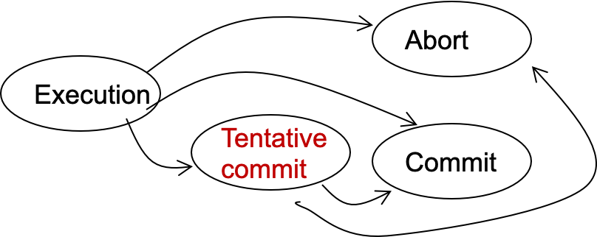
Two-phase Commit: a way to ensure multi-site atomicity
Phase-1: preparation / voting
Delay the commitment of low-layer TXs
Lower-layer transactions either abort or tentatively committed
Higher-layer transaction evaluate lower situation
Phase-2: commitment
The high-layer decides whether low-layer TXs will commit or abort
It will also coordinate the commitment of lower-layer TXs
State transitions of a TX
Notes:
Why 2 phase? Delay the commitment of TX

Slide 93
Two-phase Commit: a way to ensure multi-site atomicity
High-layer TX
发工资(bank, accts, amt):
tx.high_begin()
for acct in accts:
deposit(bank, acct, amt)
tx.high_commit()
High_begin
Mark itself as a high-level transaction
High_commit
Send prepare messages to the low-level transactions to check whether it can commit
tx.high_begin()
tx.high_commit()
for each deposit:
if deposit.abort: abort()
for each deposit:
deposit.commit()
Deposit(…)
Deposit(…)
Time

Slide 94
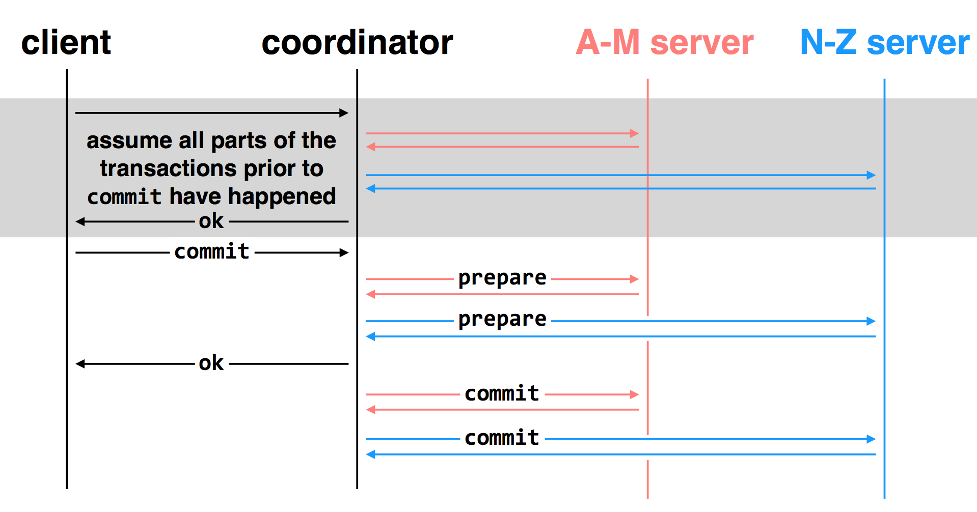
Multi-site transactions under two-phase commit
Idea: the coordinator is responsible for committing all the TXs
How? By sending RPCs or Messages to all the other servers

Slide 95
Challenge: unreliable communications, coordinator & worker

Slide 96
Multiple-site Atomicity
Principles:
Following the coordinator’s decision
Log sufficient state to tolerate failures (e.g., the coordinator’s decision)
Coordinator (do the decision & maintain the state)
Collect some ABORT or nothing: ABORT or retry
Collect all COMMIT: then COMMIT
Worker passively react to the coordinator’s actions
If no message is sent from the coordinator, just wait
When receive COMMIT: then COMMIT

Slide 97
client
coordinator
A-M server
N-Z server
assume all parts of the transactions prior to
commit have happened
OK
commit
prepare
prepare
OK
commit
commit
two-phase commit: nodes agree that they are ready to commit before committing

Slide 98
client
coordinator
A-M server
N-Z server
OK
commit
X
prepare
timeout; resend
prepare
prepare
OK
commit
commit
failure: lost prepare

Slide 99
client
coordinator
A-M server
N-Z server
OK
commit
prepare
X
timeout; resend
prepare
prepare
OK
failure: lost ACK for prepare

Slide 100

client
coordinator
A-M server
N-Z server
OK
commit
prepare
prepare
abort
abort
failure: worker failure during prepare
coordinator can safely abort transaction, will send explicit abort messages to live workers

Slide 101
client
coordinator
A-M server
N-Z server
OK
commit
prepare
prepare
OK
commit
X
Why? Just wait..
tx?
timeout; resend
commit
commit
failure: lost commit message

Slide 102
client
coordinator
A-M server
N-Z server
OK
commit
prepare
prepare
OK
commit
X
timeout; resend
commit
commit
failure: lost ACK of commit message

Slide 103

client
coordinator
A-M server
N-Z server
OK
commit
prepare
prepare
OK
commit
commit
failure: worker failure during commit
Notes:
workers write PREPARE records once prepared. the recovery process — reading through the log — will indicate which transactions are prepared but not committed

Slide 104

client
coordinator
A-M server
N-Z server
OK
commit
prepare
prepare
OK
commit
commit
tx?
restart
commit
failure: worker failure during commit

Slide 105

client
coordinator
A-M server
N-Z server
OK
commit
prepare
coordinator recovers
abort
abort
failure: coordinator failure during prepare

Slide 106
client
coordinator
A-M server
N-Z server
OK
commit
prepare
prepare
OK
commit
coordinator recovers
commit
commit
failure: coordinator failure during commit
Must log the decision before sending the commit messages

Slide 107
What about 2PL or OCC in 2PC?
Nearly identical
2PL: each low-layer TX cannot release its lock until the high-layer TX decides to commit
OCC: the validation & commit phases are done by the coordinator

Slide 108
Summary of 2-phase Commit
Two-phase commit allows us to achieve multi-site atomicity: transaction remains atomic even when they require communication with multiple machines
In two-phase commit, failures prior to the commit point can be aborted. If workers (or the coordinator) fail after the commit point, they recover into the PREPARED state, and complete the transaction
Remaining challenge: availability under coordinator failures
Follow the coordinator’s decision simplifies achieving multi-site atomicity, but what if the coordinator crashes for a long time?
We will see how to make the coordinator available in the next lecture

Slide 109
Case study: ROCOCO
Extracting More Concurrency from Distributed Transactions@OSDI’14

Slide 110



What is a Distributed Transaction？
BEGIN_TX
if (iphone > 0) {
iphone--;
}
if (case > 0) {
case--;
}
END_TX
Item | Stock
iPhone 6 Plus | 1
iPhone Case | 1
if (iphone > 0) {
iphone--;
}
if (case > 0) {
case--;
}
iPhone=1
Case=1
Transactions should be strictly serializable!…

Slide 111

Loss of serializability = angry customer

Slide 112
Serializability is costly under contention

Slide 113

OCC Aborts Contended Transactions
if (iphone > 0) {
iphone--;
}
if (case > 0) {
case--;
}
if (iphone > 0) {
iphone--;
}
if (case > 0) {
case--;
}
Commit
Execute
If (iphone > 0) {
iphone--;
}
if (case > 0) {
case--;
}
iPhone=1
Case=1
If (iphone > 0) {
iphone--;
}
if (case > 0) {
case--;
}
113

Slide 114



2PL Blocks Contended Transactions
if (iphone > 0) {
iphone--;
}
if (case > 0) {
case--;
}
if (iphone > 0) {
iphone--;
}
if (case > 0) {
case--;
}
Commit
Execute
If (iphone > 0) {
iphone--;
}
if (case > 0) {
case--;
}
iPhone=1
Case=1
If (iphone > 0) {
iphone--;
}
if (case > 0) {
case--;
}

Slide 115


Achieve serializability
w/o aborting or blocking*
* for common workloads

Slide 116

The approach of ROCOCO
if (iphone > 0) {
iphone--;
}
if (case > 0) {
case--;
}
if (iphone > 0) {
iphone--;
}
if (case > 0) {
case--;
}
If (iphone > 0) {
iphone--;
}
if (case > 0) {
case--;
}
iPhone=1
Case=1
If (iphone > 0) {
iphone--;
}
if (case > 0) {
case--;
}
Defer piece execution to enable reordering

Slide 117
Overview of ROCOCO
1. Two-phase protocol
Most pieces are executed at the second phase
2. Decentralized dependency tracking
Servers track pieces’ arrival order
Identify non-serializable orders
Deterministically reorder pieces
3. Offline workload checking
Identifies safe workloads (common)
Identifies small parts that need traditional approaches (rare)

Slide 118
#1 Two-phase protocol
Start Phase
Commit Phase
Send pieces to servers w/o executing them
Establish a final order and execute pieces
Set up a provisional order
Reorder for serializability

Slide 119
#2 Dependency Tracking: Start Phase
dep
dep
T1:
T2:
T2
T1
if ...iphone--
if ... iphone--
if ... case--
T1
if ... case--
T1
T2
T2
dep
dep
if ... iphone--
T1
if ... case--
T2
if ... iphone--
T2
if ... case--
T1
iPhone=1
Case=1
119

Slide 120
#2 Dependency Tracking: Commit Phase
dep
dep
T2
T1
T1
T2
Sort the cycle by any deterministic order
T2
T2
dep
dep
T1
T1
if ... iphone--
T1
T1
if ... case--
T1
T2
if ... iphone--
if ... case--
T1
T2
T2
T2
iPhone=1
Case=1

Slide 121

Problem: Not Every Piece is Deferrable
oid = next_oid ++
if ... iphone--
if ... case--
orderline.insert(oid, …)
Intermediate Results Calls for Immediate Execution
next_oid
iPhone
Case
orderline
orderline.insert(
oid,
……)
oid = next_oid ++
if ... iphone--
if ... case--
oid

Slide 122


Immediate Pieces are Naughty!
a = next_a++;
b = next_b++;
ol_a.insert(a, …);
ol_b.insert(b, …);
a = next_a++;
b = next_b++;
ol_a.insert(a, …);
ol_b.insert(b, …);
next_a = 0
next_b = 0
a = next_a++
b = next_b ++
a = next_a++
b = next_b ++
1. Common workloads have few immediate pieces
2. Pre-known workload → Offline check

Slide 123

#3: Offline Checking: leverage TX Chopping
S(ibling)-edge linking pieces within a transaction
An SC-cycle consists of both S-edge and C-edge
iphone
Item_Table
case
T₁
Item_Table
T₁
T₁
T₁
C(onflict)-edge linking pieces w/ conflicting access
T₂
T₂
iphone
Item_Table
case
Item_Table
SC-cycles represent potential non-serializable executions require 2PL/OCC

Slide 124

#3: Offline Checking: Enhanced
T₁
OidTable
ItemTable
ItemTable
Immediate
Deferrable
T₂
OidTable
ItemTable
ItemTable
SC-cycles with deferrable pieces can be safely reordered!

Slide 125
Incorporating Immediate Pieces
oid
oid
Every cycle contains deferrable pieces, ensured by offline checking
A cycle with deferrable pieces is safe to reorder
iphone
iphone
case
case
orderline
orderline
oid
iphone
case
orderline
oid
iphone
case
orderline
dep
dep
dep
dep
T2
T1
T1
T2
T2
T1
T1
T2
Immediate dependency
Deferrable dependency
iPhone

Slide 126

Deferred Execution
Decentralized Dependency Tracking
Offline Checking
Merged Pieces
Read-only Transactions
Reducing Dep. Size
Fault Tolerance
Overlapping Trans.
……

Slide 127
Evaluation
How does Rococo perform under contention?
How does Rococo scale?

Slide 128
Workload: Scaled TPC-C
5~15
5~15
5~15
5~15
New order
(45%)
5~15
5~15
5~15
5~15
Payment
(43%)
Read-only: OrderStatus(4%), StockLevel (4%)

Slide 129
Rococo Has Higher Throughput
Throughput

Slide 130
Rococo Avoids Aborts

Slide 131
Conclusion of ROCOCO
Traditional protocols perform poorly w/ contention
OCC aborts & 2PL blocks
Rococo defers execution to enable reordering
Strict serializability w/o aborting or blocking for common workloads
Rococo outperforms 2PL & OCC
With growing contention
Scales out

